Slide 1
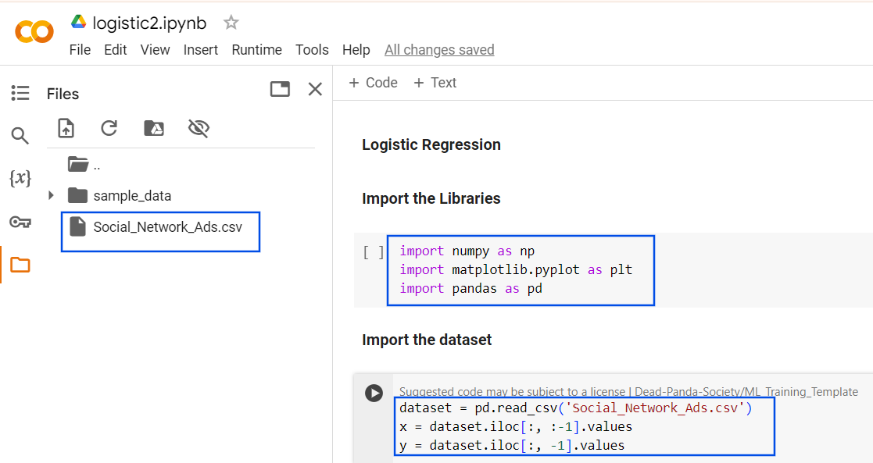
Upload the CSV File

Slide 2
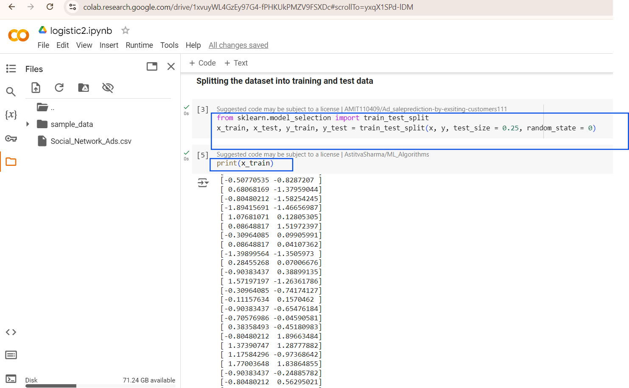

Slide 3
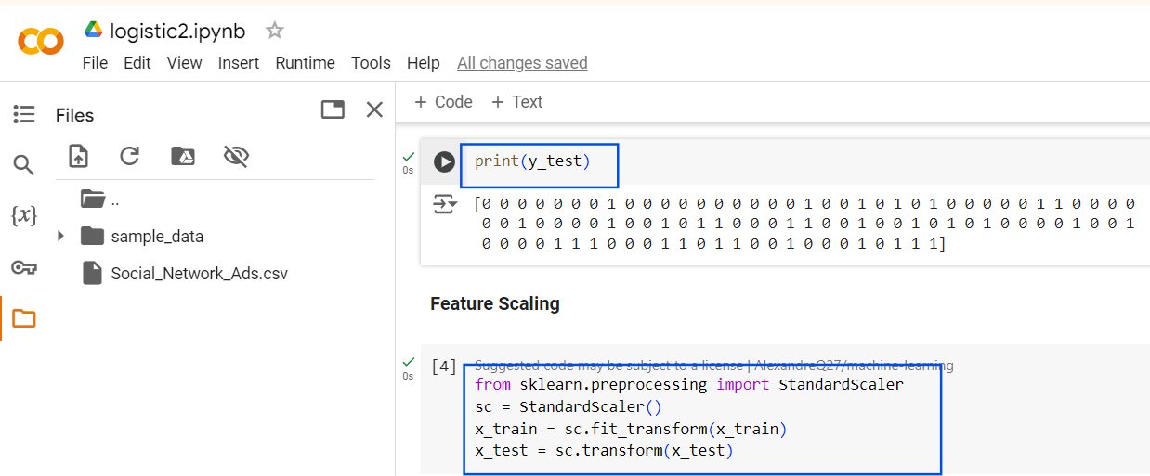

Slide 4
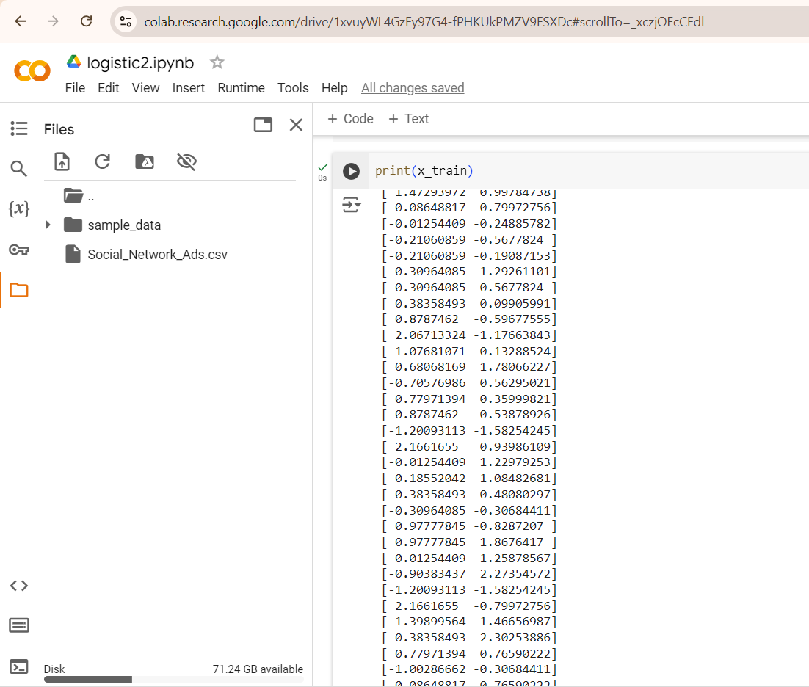

Slide 5
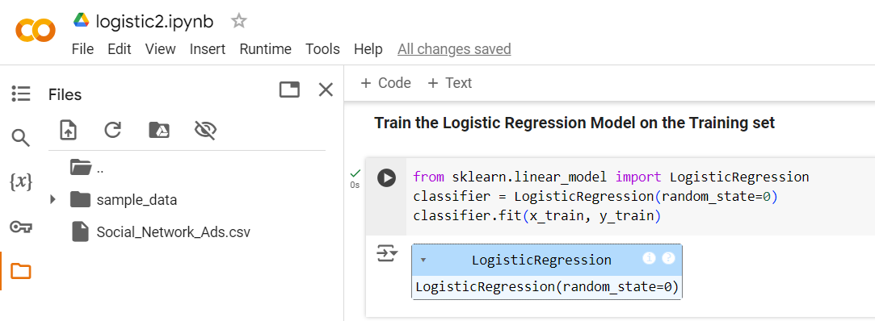

Slide 6
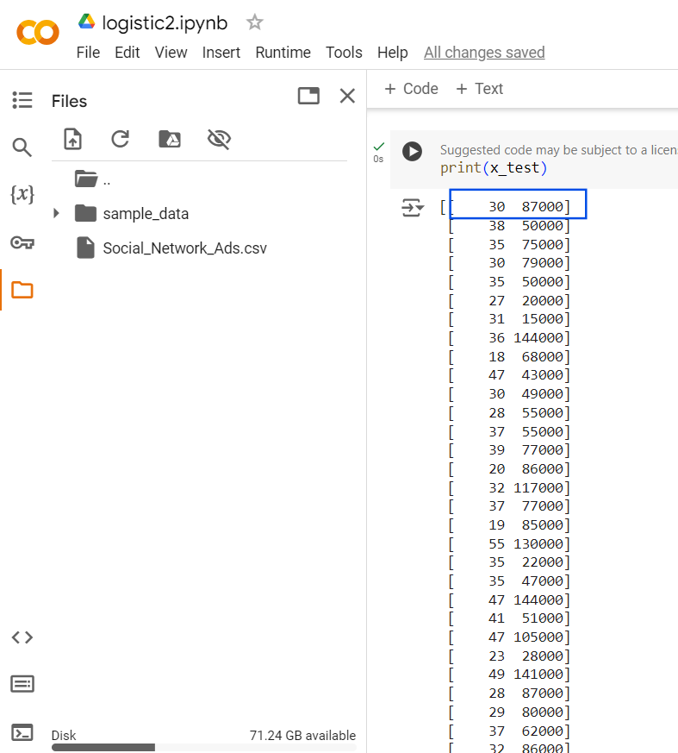
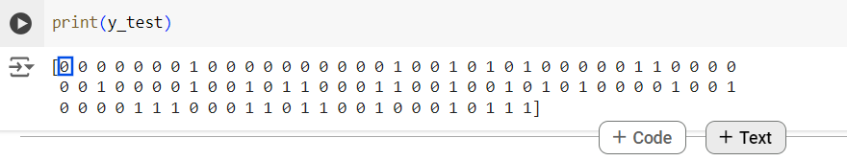
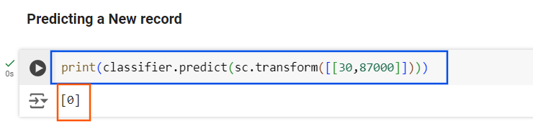
Take the First record from x_test and predict it individually using the classifier it check whether it’s getting the corresponding Y value.
While predicting iam getting the same output as expected

Slide 7
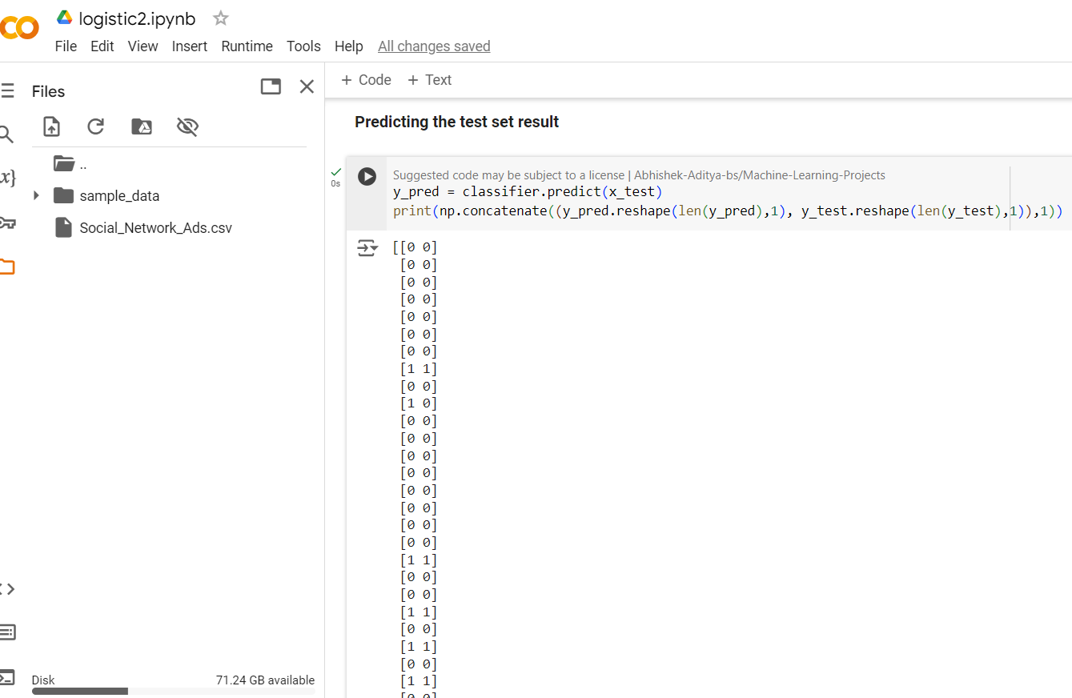
reshapes y_pred into a 2D array with len(y_pred) rows and 1 column.
reshapes the test labels into the same shape (a column vector with len(y_test) rows).
Second Argument 1
Ensures that the arrays are concatenated (column-wise), meaning the predicted labels (y_pred) and the actual labels (y_test) are placed side by side.

Slide 8
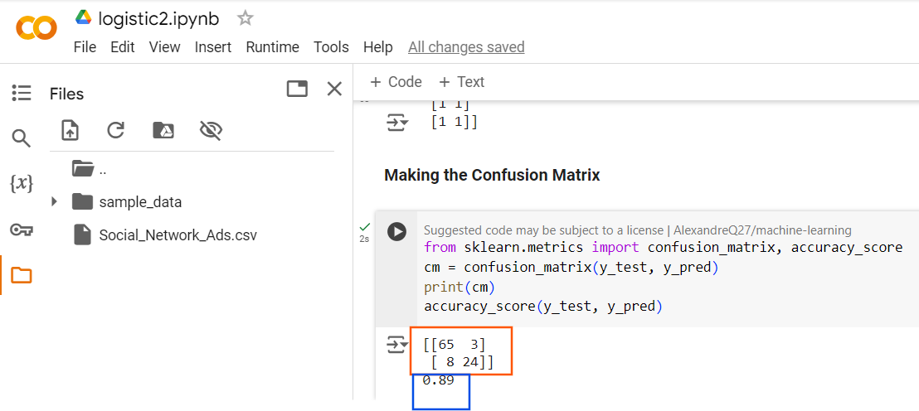
Confusion Matrix
shows
65 correct prediction of 0
3 incorrect prediction of 1
8 incorrect prediction of 0
24 correct prediction of 1
Accuracy is 89%

Slide 9
